Slide 1
Programming in C++

Slide 2
Basics of C++
A very simple example
template<typename T> class P : protected X<T>
{
private :
P(long=0);
P* _makeInstance();
std::pair<char, bool> _properties;
static P* __instance;
public :
const T& operator[](std::string& idx) const;
friend ostream& operator<<(ostream &os, const P<T> p);
virtual std::string& what()=0;
}
P* P::__instance=NULL;

Slide 3
Computer science and programming
Language syntax
Algorithm design
Programming / coding
Software development
Language paradigm

Slide 4
Language syntax
Most of C Language
New syntax from the C++ language paradigm
C++ is a tool to implement an Object Oriented Design

Slide 5
C++ vs C - paradigm
C language :
A unique global space containing :
global variables
functions
Types :
Built-in types
User defined types :
enum
struct

Slide 6
C paradigm
Function definitions : global space
function Y
Function prototypes : dictionary
function Z
function X
variables
variables
variables
function X
code
function Y
code
code
function Z
function F
function G
function F
function G
variables
variables
User defines types : dictionary
code
code
struct p
struct q
enum e

Slide 7
C - Weak type association
Defining a new type (enum or struct) : design
Purposes of designing / creating a struct :
unifying data makes sense
A person has :
a name / a firstname – a lastname
an age / a birthdate
an address

Slide 8
Weak type association - continued
List the subtypes :
A person has :
a name
a birthdate
an address
A person has :
a name char*
a birthdate struct date
an address char*
List the subtypes :
A date has :
a day
a month
a year
A date has :
a day int
a month int
a year int

Slide 9
C definition of types
struct s_date
{
int dd,mm,yy;
};
struct s_person
{
char *name;
struct s_date birthdate;
char *address;
};
Used only for memory organisation and handling : C computes the size of user defined types and offsets of fields.

Slide 10
Functions associated to types
BUT : designing a person or date type implies much more !
What would be useful to do with a date variable ???
Print it (in a pretty way)
Scan or read it
Check its correctness
Compute the difference between two dates
…

Slide 11
How C does it
Printing a date :
void printDate(struct s_date); prototype
void printDate(struct s_date d) definition
{
printf(″%d/%d/%d″, d.dd, d.mm, d.yy);
return;
}

Slide 12
Why is this somehow clumsy ?
Because :
printf already exists for built-in types / but not reusable
void printDate(struct s_date);
Association done by : function name and parameters
Redundant, uneasy to remember, not unified

Slide 13
How C++ can handle this
Using classes
With C : a type is a model used to create variables
Ex : float f; f is a variable created with the float model
f is stored in a block of 4 bytes (32 bits)
float also describes how f is stored in binary

Slide 14
How C++ can handle this
Using classes
With C++ : a class is a model used to create objects
As in C : memory handling purposes
But adds a strong type association for functions
Some functions are associated to classes and become methods

Slide 15
What is a C++ class
The Date class as an example
This example presents
syntax
concepts of objects
association of functions to objects

Slide 16
Class definition syntax
A class definition is like a struct
it’s a type, a model
Definition lies in a header file : .h
See date_example project
class Date
{
};

Slide 17
Class definition syntax : adding fields
Just as C structs : list the fields
class Date
{
int dd,mm,yy;
};
In C++, fields are called attributes
Here is your first class definition !

Slide 18
Creating an object
Just like creating a variable :
Class_name object_name;
Example :
Date d1; // creates an object named d1

Slide 19
Accessing attributes
Just like accessing a field in a plain old C struct : use the dot (.) operator

Slide 20
Live lab ! First example on moodle (TI130I)
Now it’s up to you…
Don’t rush !
Take profit form :
code completion utility
build messages and logs

Slide 21
Live debriefing

Slide 22
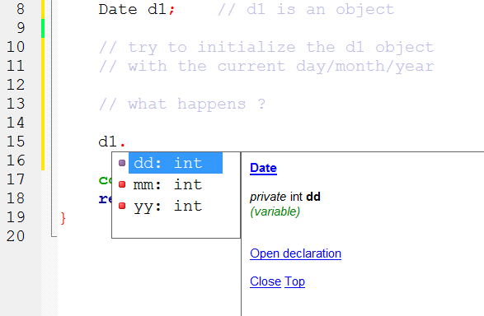
Attributes accessibility
The dd, mm and yy attributes are private
Clues

Slide 23
C++ private qualifier
Default behavior of C++
In C, all is public
A private attribute cannot be accessed or selected directly.
So, how can we do ???

Slide 24
First solution :
Qualify those attributes as public :
Using the syntax : public:
Before the list of the attributes
Your turn : edit the example_date.h file

Slide 25
Live debriefing

Slide 26
private vs public
Default behavior is private : why ?
For a Date :
month mm range from 1 to 12
year yy can be any value
day dd range from 1 to 28,29,30,31,depending on mm and yy values

Slide 27
Second solution
Attributes remain private
They can be modified (set) and/or accessed (get) by methods (functions)
Use methods as attributes, with the dot (.) operator (see later)
Example for the mm attribute

Slide 28
Live lab ! Get and set methods
Now it’s up to you…
Don’t use the .cpp code file for the moment
Just use the .h file

Slide 29
Step 1
Make the attributes private
Make the methods public
Compile – run – modify the main.cpp file to display the mm month attribute

Slide 30
Step 2 : the .h/.cpp files
What the .h files states
class Date
{
int dd,mm,yy;
public :
void setMonth(int);
int getMonth();
};
Class name
private attributes
public methods prototypes
Prototypes are inside the class definition

Slide 31
What a method prototype states
class Date
{
int dd,mm,yy;
public :
void setMonth(int);
int getMonth();
};
The setMonth() method is associated to the Date class and its objects
This method is not in a global space
This method belongs to the namespace of the Date class
It’s complete prototype is : void Date::setMonth(int)

Slide 32
Method definition
setMonth() method
Prototype in .h file
Definition in .ccp file, using the complete name :
void Date::setMonth(int month)
{
mm = month;
return;
}
private attributes can be accessed from methods of the same class
mm is private

Slide 33
How to call setMonth() method
This method can only be called by a Date object
d1.setMonth(12) associates d1 to the method call
Means « use setMonth(12) with d1 object »
Works like having d1 as a parameter

Slide 34
Live lab ! Discover ‘this’
Now it’s up to you…
Edit the .ccp files to display this

Slide 35
How to call setMonth() method (2)
Works like having d1 as a parameter
That’s what happens !
Calling a method through an object sends the address of the object to the method
d1.setMonth(12) is equivalent to : Date::setMonth(&d1,12)
The address is available inside the method as a value named this

